Slide 1

Customer success
Monthly support report
Lazar Milicevic
Key metrics, achievements, roadmap & next steps
February 2025

Slide 2
Agenda
1
Part I: Abstra support key metrics
2
Part II: Achievements & roadmap
3
Part III: Roadmap items
deep dive
4
Part IV: Product Insights
5
Part V: Next steps

Slide 3
Executive Summary
Customer success: Monthly Support Report - February 2025
Metrics summary:
206 tickets handled in February ( +178% compared to January ), driven by new Hackathon users.
First response time: 21 min – 15.7x faster than January and 4x faster than December 2024.
Resolution time: 6.7 hrs, a 26% improvement from January and well below the 24-hour standard. CSAT: 96.3%, maintaining high satisfaction despite increased ticket volume.
SageMaker Support Process - Zendesk/AWS Integration
The integration is now fully operational, significantly improving efficiency and automation.
13 SageMaker blocking issues were processed seamlessly, with an average full resolution time of just 1.1 hours – a very nice improvement over standard resolution times.
These tickets were automatically routed to AWS Support, eliminating manual triage delays and ensuring swift issue resolution.
Thanks to automation, the team has minimized disruptions, allowing us to focus more on proactive support and optimizations.
TL;DR - Most important points in one place!
Ongoing Issue - Documentation & User Access Review
Reviewing and optimizing external user onboarding materials to improve clarity and access, ensuring that all key documentation updates align with the latest process changes.
Expected completion by mid-March, followed by finalizing Owkin K documentation, which I’m really excited to work on!
SurveySparrow NPS Tool Implementation: The NPS widget code has been created and is ready for implementation on the Owkin K website.
I am currently testing the SurveySparrow NPS tool and will collaborate with frontend developers and an external design team to finalize the integration by the end of March.

Slide 4

Agenda
1
Part I: Abstra support key metrics
2
Part II: Achievements & roadmap
3
Part III: Roadmap items
deep dive
4
Part IV: Product Insights
5
Part V: Next steps

Slide 5
Abstra at a glance - Fullstory Metrics
Customer success: Monthly Support Report - February 2025
A general overview of numerical metrics and feature adoption compared with previous month
General Metrics
Catalog Metrics
Slide Viewer Metrics
Other Metrics
Active Users
135
+5.5%
Dataset Search
1100
+12.5%
Users
49
+14.0%
Target Directory Users
25
-19.4%
New Users
58
+286.67%
Dataset Views
3312
+5.1%
Sessions
357
-1%
Average session
per user
37
+7.8%
Abstra
Documentation
27
-15.6%

Slide 6
Key metrics overview
Customer success: Monthly Support Report - February 2025
General monthly key metrics
February was a breakthrough month with faster response times, increased efficiency, and a growing user base.
📈 206 tickets handled (+178%) – driven by new Hackathon users. ⚡ First response time: 21 min – 15.7x faster than January, 4x faster than December 2024. ⏳ Resolution time: 6.7 hrs – well below the 24-hour standard. ⭐ CSAT: 96.3% – maintained despite higher ticket volume.
Key Wins:
✔ 93.6% faster first responses – resolved ticket visibility issues and ensured every ticket got a response within 15 min before assignment. ✔ Rapid resolutions – averaging 6.7 hours, far exceeding the 24-hour standard. ✔ Scalability – handled increased demand without compromising quality.
We’re focused on further reducing resolution times and improving efficiency as we continue to grow.
January
February
Change
Tickets Received
74
206
+178.38%
Solved/Received
93.24%
78.16%
-16.17%
Average First Response Time (Bus. hrs.)
5.5 hrs
21 min
-93.64%
Average Full Resolution Time (Bus. hrs.)
9.1 hrs
6.7 hrs
-26.37%
% Satisfied CSAT
100%
96.3%
-3.70%
*Times are in business hours.

Slide 7
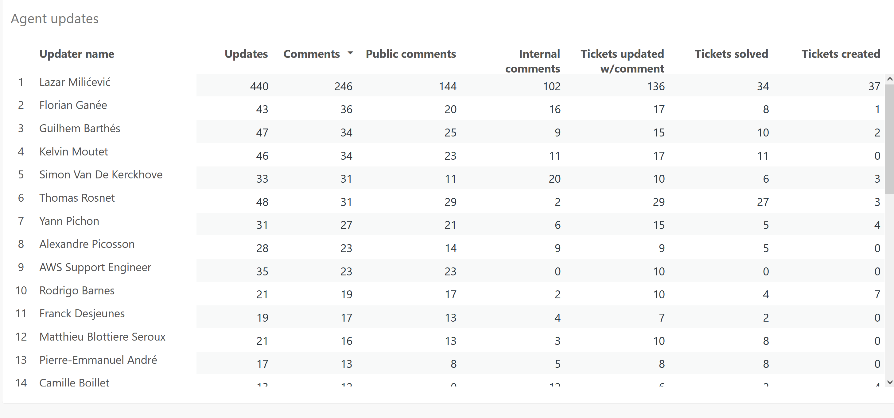
Monthly Ticket Counts & Average Resolution Times
Customer success: Monthly Support Report - February 2025
Compared with previous 3 months
2024/25
Tickets Received
Avg. Full Resolution Time
November
72
5.7 hrs
December
67
8.8 hrs
January - 2025
119
9.1 hrs
February - 2025
206
6.7 hrs
*Times are in business hours.
February Summary
✔ 206 tickets handled (+73% from January), driven by Hackathon users. ✔ First response: 21 min – faster engagement. ✔ Resolution time: 6.7 hrs – well below the 24-hour standard. ✔ CSAT: 96.3% – maintained despite higher volume.
We’ll keep optimizing to reduce resolution times and scale efficiently.

Slide 8
Blocking issues key metrics overview
Customer success: Monthly Support Report - February 2025
Monthly metrics and changes for the reported blocking issues
February saw a significant increase in blocking issues, with 11 reported cases—more than double January's count. This was largely due to the onboarding of Hackathon users, who required urgent support.
Despite the increase, we achieved record response and resolution times: ✔ First response time: 12 min – 58% faster than January and 20x faster than December. ✔ Resolution time: 3.8 hrs – 96% faster than January and 50% faster than December.
Looking at past months, the trend is clear:
First response time improved from 4.1 hrs (Dec) → 29 min (Jan) → 12 min (Feb).
Resolution time dropped from 7.7 hrs (Dec) → 9.1 hrs (Jan) → 3.8 hrs (Feb).
The AWS-Zendesk integration played a key role in this improvement, enabling faster triaging, streamlined ticket processing, and improved efficiency. As we continue refining our support processes, we anticipate even faster resolutions and greater stability moving forward.
January
February
Change
Tickets Received
5
11
+120.00%
Solved
5
10
+100.00%
Average First Response Time (Bus. hrs.)
3.3 hrs
0.2 hrs
-93.94%
Average Full Resolution Time (Bus. hrs.)
85.7 hrs
3.8 hrs
-95.57%
*Times are in business hours.

Slide 9
Number of tickets received per topic
Customer success: Monthly Support Report - February 2025
Increasing tickets related to Dataset Creation as well as SageMaker issues.
February saw a surge in user account creation requests, with 23 tickets for external user creation, 22 of which were Hackathon users. This reflects the growing engagement of new users and the demand for streamlined onboarding.
Other notable topics: ✔ 9 tickets for CI access to CodeArtifact package registry. ✔ 5 tickets for Dataset file management. ✔ 2 tickets for Abstra Project creation. ✔ 1 ticket for AWS S3 Dataset IO issues.
Topic
Tickets
Allowing CI to access codeartifact package registry
9
AWS S3 Dataset IO
1
Create a new Abstra Project
2
Create External User Account
23
Dataset::Data files management (ingesting, moving and deleting files)
5
Notes:
rank by desc order

Slide 10
Trend in topics received compared with previous month
Customer success: Monthly Support Report - February 2025
Highest changes in number of tickets received per topic
January
February
Change
External User Account Creation – The most significant increase, with 23 new accounts created, 22 of which were Hackathon users, highlighting a surge in new user onboarding.
CI Access to CodeArtifact – 80% increase driven by new project setups and expanded automation needs for pipeline deployments.
AWS S3 Dataset IO – A new category in February, reflecting growing interest in dataset storage and access.While some categories saw fewer requests, the spike in new users and infrastructure-related support suggests higher platform engagement and evolving user needs.
Allowing CI to access codeartifact package registry
5
9
+80.00%
AWS S3 Dataset IO
0
1
100%
Create a new Abstra Project
5
2
-60.00%
Create External User Account
0
23
100%
Dataset::Data files management (ingesting, moving and deleting files)
6
1
-83.33%

Slide 11
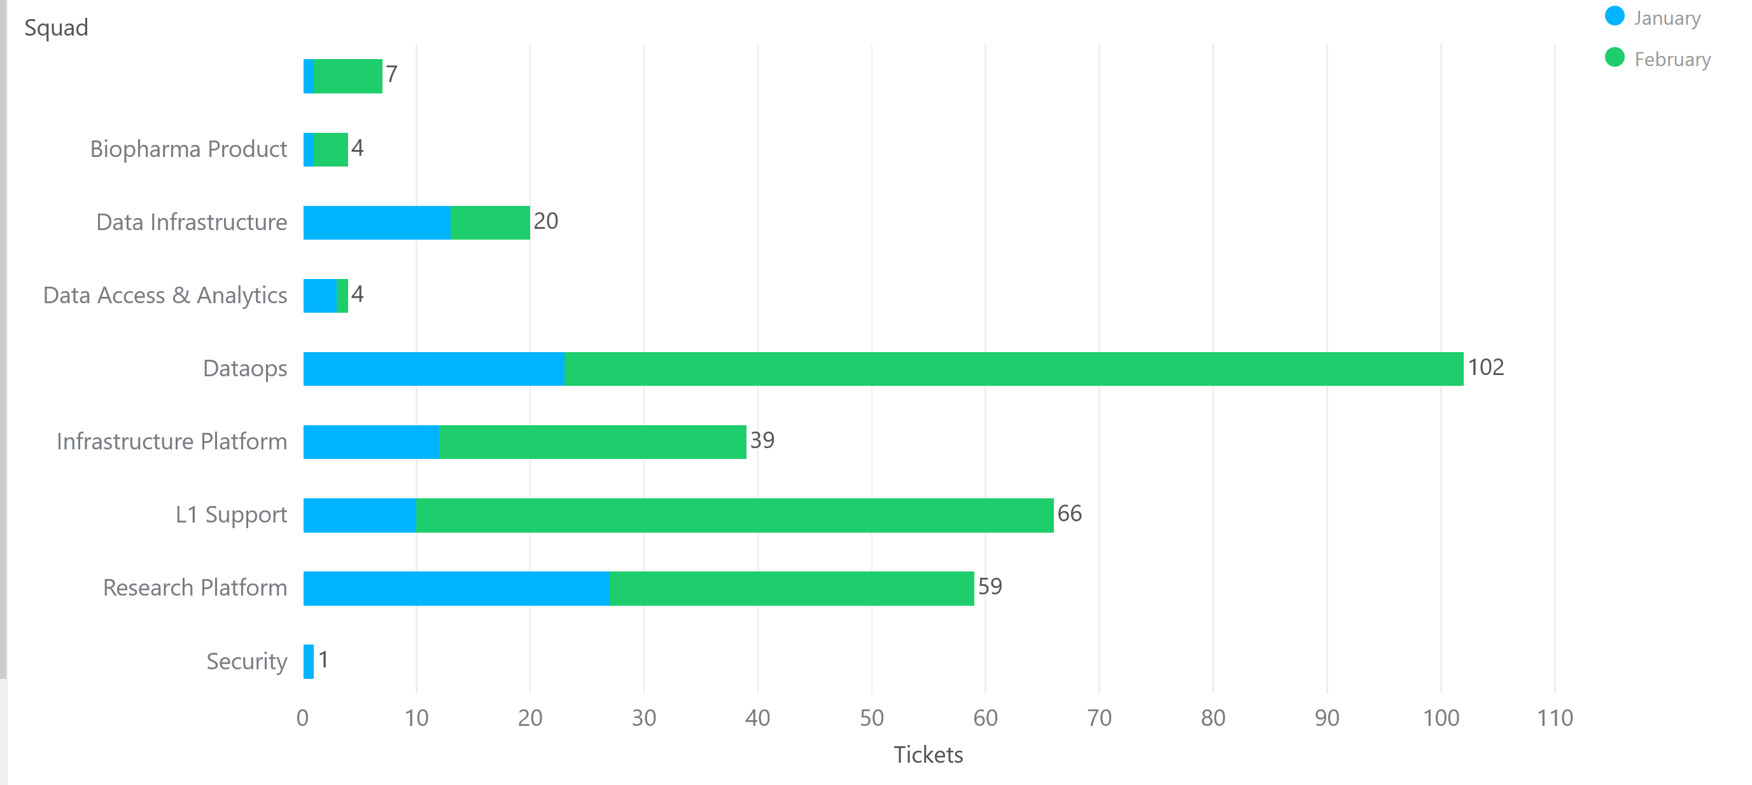
Tickets per squad
Customer success: Monthly Support Report - February 2025
Month-over-Month (MoM) Overview for ticket counts per squad
The DataOps squad saw a major surge, handling 102 tickets, making it the most active support area. This increase aligns with the onboarding of Hackathon users, who required extensive setup and troubleshooting.
The L1 Support and Research Platform squads also handled a high volume of requests, reflecting continued engagement from both new and existing users.
Meanwhile, the Infrastructure Platform squad managed 39 tickets, maintaining its role as a key support area for AWS access, repositories, and system configurations.
Overall, February’s ticket distribution highlights scalability challenges and evolving support demands as user adoption grows.

Slide 12
Help Center article views - December 2024
Customer success: Monthly Support Report - February 2025
Most viewed help center articles in the month
Top articles viewed this month:
Article
Views
"HOME PARTITION FULL" warning message
41
Requesting compute resource for your workspace (AWS)
37
Abstra access requests
30
My workspace is not starting
29

Slide 13


🏆
Superstar of the month!
Part title
Jorge Arellano Castro
Handling most number of L2 tickets
Clément Fleury
For having the least first response time of 0.1 business hours

Slide 14

Agenda
1
Part I: Abstra support key metrics
2
Part II: Achievements & roadmap
3
Part III: Roadmap items
deep dive
4
Part IV: Product Insights
5
Part V: Next steps

Slide 15
Customer success roadmap timeline
Customer success: Monthly Support Report - February 2025
Main topics we aim to achieve through Q1-25.
January
February
March
Reduce number of reported blocking issues by 50%
Finalize Integrating Zendesk with AWS Support for SageMaker tickets
Educate users about the process workflow for SageMaker support
Providing full support for the Hackathon users
Finalize the process to handle internal vs external Abstra documentation
Handling 60% of ALL tickets at L1 level
Bringing support to a new level, continuously maintaining a first response rate below 20 minutes.
Finalizing the Owkin K documentation
Handling more l2 tickets
February Highlights:
AWS-Zendesk integration fully operational, streamlining SageMaker ticket handling.
Full support for Hackathon users managed efficiently.
User education & L2 ticket handling improved, enhancing workflow.
Preparing for March goals: faster responses & better ticket management.

Slide 16
Agenda
1
Part I: Abstra support key metrics
2
Part II: Achievements & roadmap
3
Part III: Roadmap items
deep dive
4
Part IV: Product Insights
5
Part V: Next steps

Slide 17
Customer success Q1 Roadmap items (RIs)
Customer success: Monthly Support Report - February 2025
01
Abstra Global Support | AWS Support- Zendesk Integration
02
Leverage Fullstory insights
03
Abstra Documentation page visibility

Slide 18
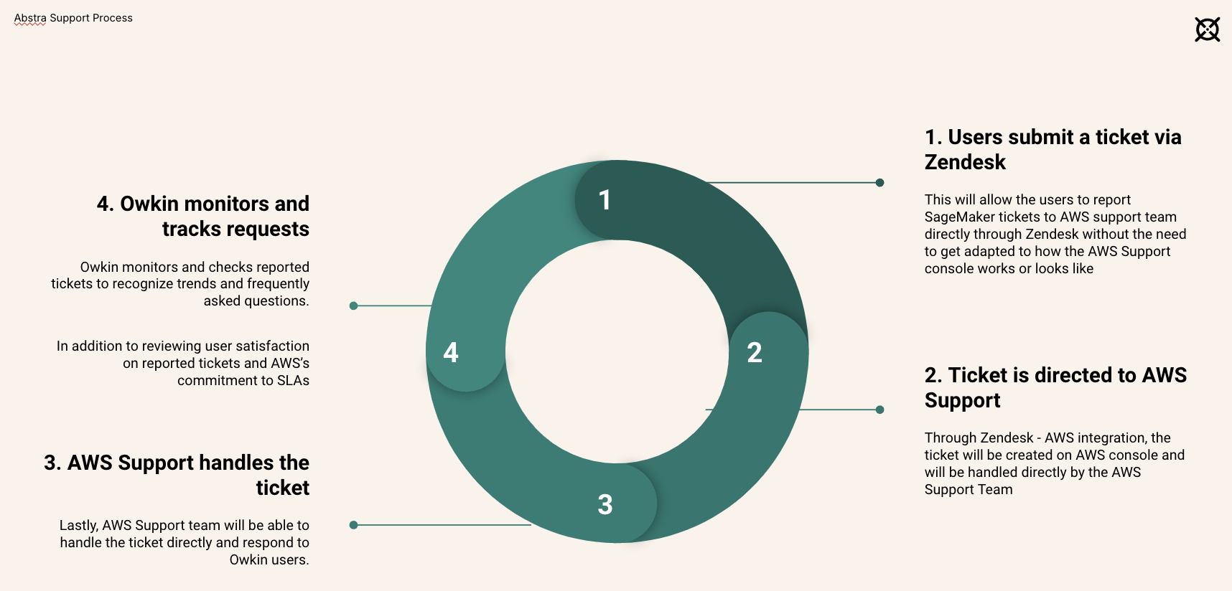
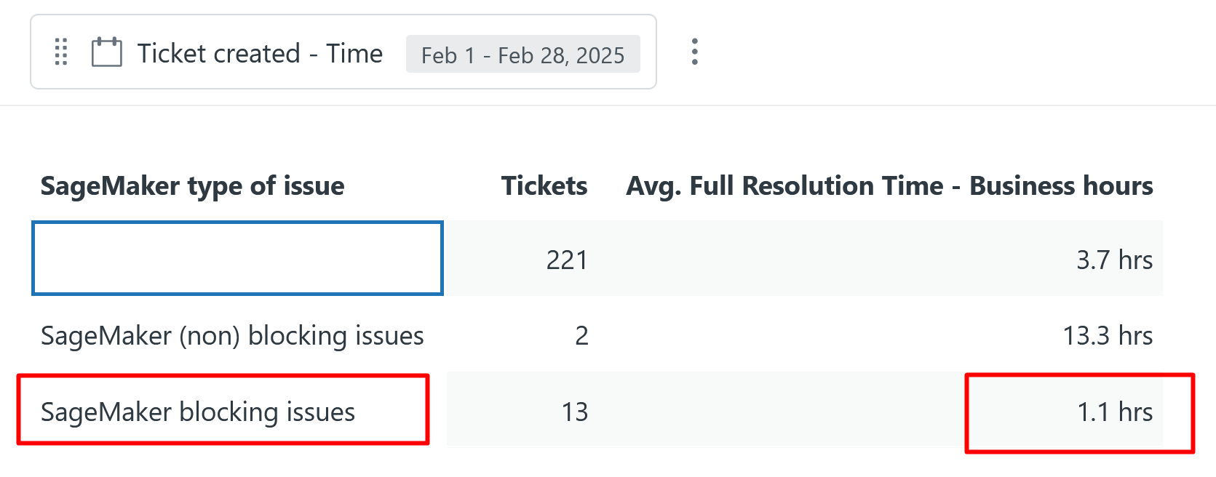
RI#1: Abstra Global Support
Process
AWS Support- Zendesk Integration
Customer success: Monthly Support Report - February 2025
🚀 Since going live, the new workflow successfully processed 13 SageMaker blocking issues through the new form, all automatically routed to AWS Support for faster handling. With an impressive average full resolution time of just 1.1 hours, the integration has drastically improved efficiency in resolving critical issues. However, direct comparisons to previous months aren’t possible, as these tickets were not previously tagged and categorized using the AWS-Zendesk integration. This marks a significant leap in automation and response speed, ensuring minimal disruptions while allowing the team to focus on proactive support.
Workflow after SageMaker migration
Slide Deck

Slide 19
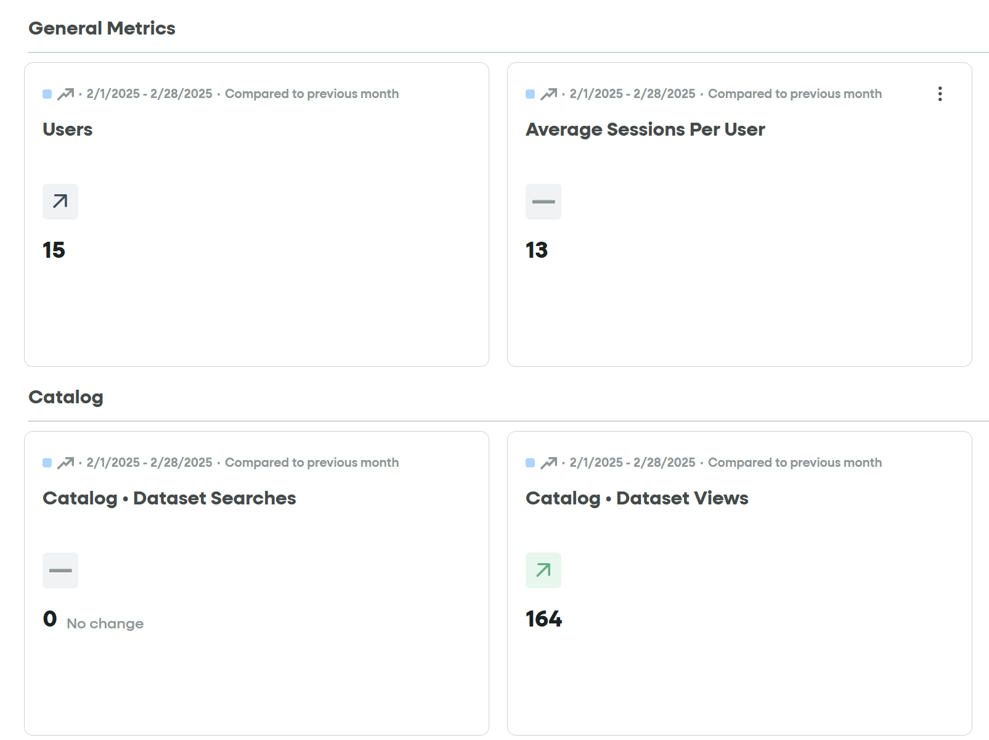
RI#2 Leverage Fullstory insights
With the new segment in place, we now have real-time visibility into Hackathon user activity on Abstra. This enables: ✅ Faster issue detection – Identify login problems, navigation difficulties, and errors early.
✅ Data-driven decisions – Improve onboarding and feature adoption based on user struggles.
✅ Optimized platform performance – Use insights to enhance the user experience for future events.
Customer success: Monthly Support Report - February 2025
We have created a new segment for Hackathon users, now visible on the Abstra dashboard in FullStory. This allows us to track engagement, analyze user behavior, and improve onboarding based on real interaction data.

Slide 20
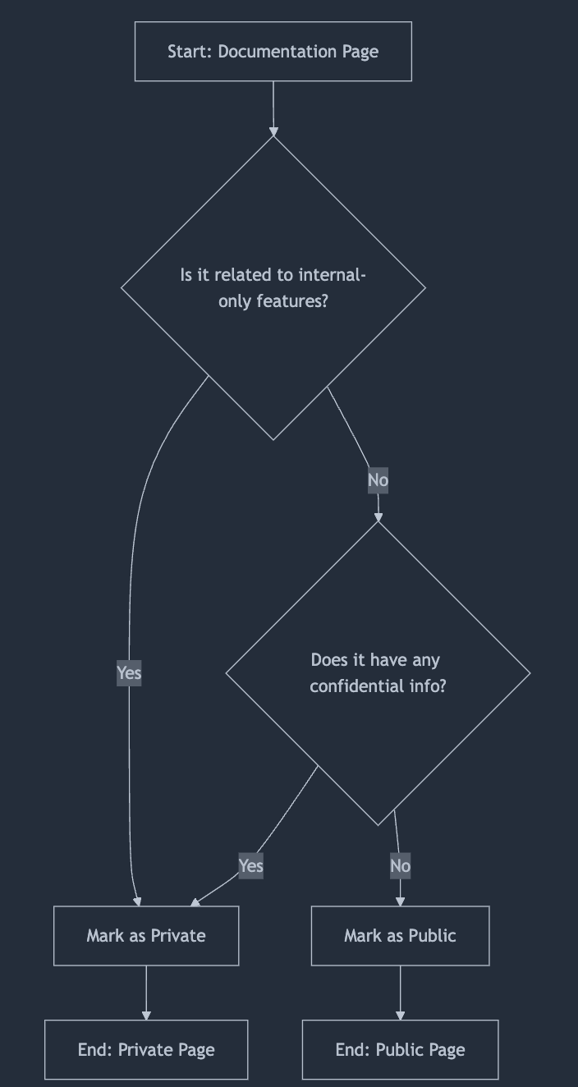
RI#3: Abstra Documentation page visibility
Customer success: Monthly Support Report - February 2025
(WIP) a solution where we can make pages visible per user organization
A decision-making process to decide whether a page in Abstra documentation should be private to internal Owkin users or public and can be viewed by external partners too. You may find the process here.
We are currently reviewing the documentation to ensure it aligns with the latest updates and provides clear, structured guidance for external users.
The focus remains on assessing access limitations and updating content for a smoother onboarding experience.
By mid-March, we aim to finalize this process, making documentation more accessible and informative. Additionally, I look forward to working on the Owkin K documentation throughout the month, ensuring it serves as a valuable resource.

Slide 21
Agenda
1
Part I: Abstra support key metrics
2
Part II: Achievements & roadmap
3
Part III: Roadmap items
deep dive
4
Part IV: Product Insights
5
Part V: Next steps

Slide 22
Next steps for Customer Success
Customer success: Monthly Support Report - February 2025
Finalizing Zendesk & AWS Support Integration
→ Monitor and optimize the Zendesk-AWS workflow to ensure smooth ticket routing. → Maintain first response time under 20 minutes while increasing L2 ticket resolution. → Continue improving response time and handling critical support requests efficiently.
Educate Users on the Owkin K Onboarding Process
→ Prepare onboarding materials (FAQ, documentation, videos) for the March 31st launch. → Ensure a structured onboarding experience for internal users. → Organize a knowledge-sharing session to streamline adoption.
Please do not hesitate to reach out to me for any questions.
Enhance Support & Implement NPS Tool
→ Survey Sparrow NPS tool is in testing, widget code ready for Owkin K site integration. → Collaborate with frontend developers and an external design team to implement by March. → Increase L2 ticket handling to at least 60% while keeping high CSAT scores. → Finalize external user documentation updates in early March to align with recent process improvements.

Slide 23
Agenda
1
Part I: Abstra support key metrics
2
Part II: Achievements & roadmap
3
Part III: Roadmap items
deep dive
4
Part IV: Product Insights
5
Part V: Next steps

Slide 24
Thank you!

